Slide 1
DESIGN AND ANALYSIS OF ALGORITHMS · DAA
Dijkstra’s Shortest Path Algorithm
From weighted graphs to a guaranteed shortest route.
Student: Aanya Mishra · prn: 25070521279 · sem/Section: 3/E-2
Generated using Gamma
Notes:
Introduce the algorithm as a method for turning a weighted network into a set of shortest-route decisions. The deck moves from graph vocabulary to the greedy rule, then through one complete example.

Slide 2
THE CORE IDEA
Shortest paths turn weighted graphs into decisions
At every stage, the algorithm asks one practical question: which reachable vertex can now be settled safely?
Find the minimum
Keep the route
Reason over networks
Finds the minimum-cost path from one source vertex to every reachable vertex in a weighted graph.
Returns both the best-known distance and the predecessor chain used to reconstruct the route.
It is a core single-source shortest-path idea in graph algorithms and network reasoning.
2
Notes:
Emphasize that Dijkstra returns more than a number. It maintains the cost of the best route found so far and enough predecessor information to rebuild the route itself.

Slide 3
GRAPH VOCABULARY
A graph is a map of vertices connected by weighted edges
Vertex
Edge
An object or location such as A, B, or C.
A connection between two vertices.
A
4
B
2
3
Weight
Source and destination
The cost of using an edge: distance, time, or delay.
C
D
Where the route starts and where it ends.
1
Weight = edge cost. A weighted graph records both connectivity and cost.
3
Notes:
Define the five terms before using the algorithm. The graph is not just a map of connections; every edge carries a cost that the algorithm must compare.

Slide 4
WHY THE GREEDY STEP WORKS
Dijkstra makes a greedy choice that stays safe
Choose the smallest tentative distance
Non-negative weights make the choice safe
Greedy algorithms choose the best-looking option available at each step. Dijkstra selects the unvisited vertex with the smallest tentative distance.
With non-negative edge weights, that distance cannot later be improved by going through a farther vertex. Negative edge weights break this guarantee; Bellman–Ford is the alternative for graphs that may contain them.
4
Notes:
The safety argument depends entirely on non-negative weights. Once a vertex has the smallest tentative distance, any route reaching it through another unsettled vertex would already be at least as expensive.

Slide 5




STEP 1 · SET THE STATE
Initialization records what is known and what is not
Before the first choice, every vertex receives a safe default.
Input: a weighted graph and a source vertex .
Set ; set every other distance to .
Mark every vertex unvisited.
Set until a best preceding vertex is found.
Remember: The distance array stores current best costs; the predecessor array reconstructs the final path.
5
Notes:
Initialization does not claim that every infinity is truly unreachable. Infinity means only that no route has been discovered yet. The arrays will change as the algorithm explores edges.

Slide 6




STEP 2 · UPDATE THE STATE
Relaxation improves a route one edge at a time
Each pass tests whether reaching a neighbor through the current vertex is cheaper.
01
02
Extract
Test
Choose the unvisited vertex with the smallest tentative distance.
For each unvisited neighbor, compute .
03
04
Decide
Record
If the candidate is smaller, update and .
Mark visited and repeat until the destination is settled.
Decision point
Shorter route found? Yes → replace the distance and predecessor. No → keep the current record.
6
Notes:
Relaxation is the local improvement operation. It never guesses the final answer; it only replaces a current record when one edge gives a cheaper route.

Slide 7
WORKED EXAMPLE
4
A
B
Example: route from A to E
1
2
1
7
C
5
D
3
E
Use an undirected weighted graph with five vertices and these seven edges.
Edges: A–B = 4 · A–C = 1 · C–B = 2 · B–D = 1 · C–D = 5 · D–E = 3 · B–E = 7
Source: A · Destination: E
The final route will be highlighted after the distances settle.
7
Notes:
Read the graph as undirected: each listed edge can be traversed in either direction. Do not add any edge that is not in the supplied example.

Slide 8
THE DISTANCES SETTLE
The shortest route settles at cost 7
Start with A = 0 and all other distances = ∞. Process vertices in this order: A, C, B, D, E.
Processed | A | B | C | D | E | Key update
Start | 0 | ∞ | ∞ | ∞ | ∞ | Source A = 0
A | 0 | 4 | 1 | ∞ | ∞ | A→B, A→C
C | 0 | 3 | 1 | 6 | ∞ | C→B improves 4→3; C→D = 6
B | 0 | 3 | 1 | 4 | 10 | B→D improves 6→4; B→E = 10
D | 0 | 3 | 1 | 4 | 7 | D→E improves 10→7
E | 0 | 3 | 1 | 4 | 7 | Destination settled
FINAL PREDECESSOR CHAIN
E ← D ← B ← C ← A
Shortest path: A → C → B → D → E
Total cost: 1 + 2 + 1 + 3 = 7
8
Notes:
Point out the two improvements: C changes B from 4 to 3, and B changes D from 6 to 4. Finally D changes E from 10 to 7. The predecessor chain then reconstructs the route backwards.

Slide 9
DIJKSTRA(G, source):
for each vertex v in G:
distance[v] ← ∞; predecessor[v] ← NIL; visited[v] ← false
distance[source] ← 0
while there is an unvisited vertex:
u ← unvisited vertex with minimum distance[u]
visited[u] ← true
for each neighbor v of u:
candidate ← distance[u] + weight(u, v)
if candidate < distance[v]:
distance[v] ← candidate
predecessor[v] ← u
return distance, predecessor
Pseudocode: repeat extract, relax, and record
Initialize safe defaults; select the next settled vertex; test each outgoing edge during relaxation; predecessors rebuild the route.
9
Notes:
Read the pseudocode top to bottom. The same four ideas appear in the worked example: initialize, extract the smallest distance, relax its neighbors, and return both arrays.

Slide 10
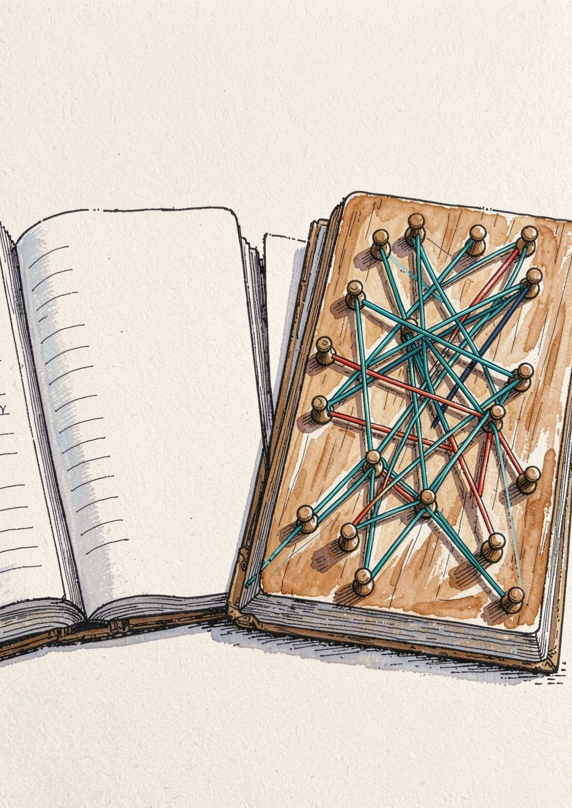
COMPLEXITY AND LIMITS
Efficiency comes from the graph representation
The data structure determines how quickly the next smallest distance can be found.
TIME
SPACE
O((V + E) log V)
O(V + E)
Adjacency-list storage; distance, predecessor, visited, and queue data add O(V).
With an adjacency list and a min-priority queue.
A good representation makes repeated choices efficient.
Notes:
Close on the trade-off. Adjacency lists keep the graph proportional to its vertices and edges, while the min-priority queue makes repeated minimum selection efficient. Dijkstra is systematic and reliable for non-negative weights, but Bellman–Ford is required when negative edges may appear.

Slide 11
